Slide 1


Slide 2

Case Study: FIFA - MoneyBall
Luca Ciceu
Feb 13, 2021

Slide 3
Project approach:
Setting up a Trello board to better organize (can be found here)
Teamwork: discussing with my teammates (Agatha and Lupo) what is the best way to go about this particular dataset
Looking at a bunch of videos and data analysis case by many, many Indian fellows

Slide 4
The plan:
Data Cleanup (in Jupyter Notebook)
Model training (regression)
Documenting the Notebook
Making (this) the presentation
Kick ass and chew bubblegum!

Slide 5
Planned outcomes:
Grouping players by club, position and age, ova and pot
Bonus: wage vs value distribution
Verifying several mixes:
Best team by overall value
Best team by potential
Best Romanian team..
Predicting player market value via regression

Slide 6
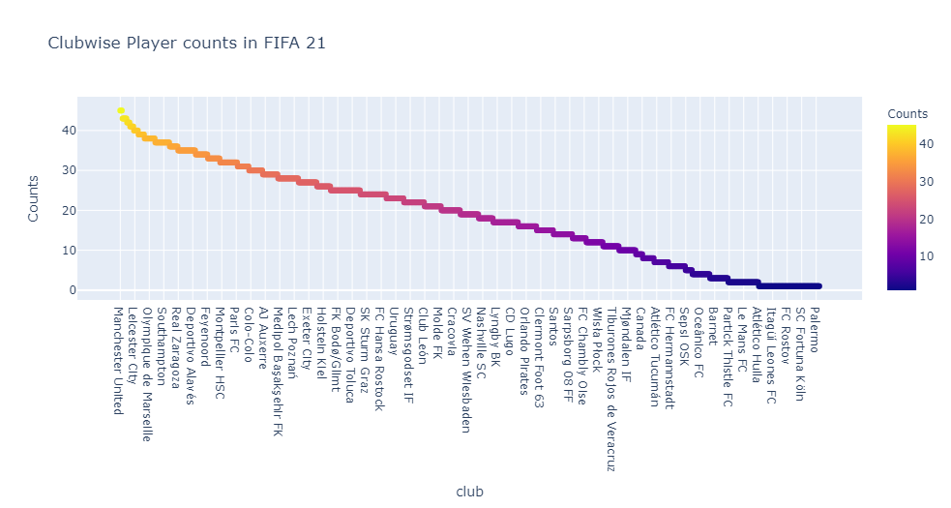
Grouping players by club

Slide 7
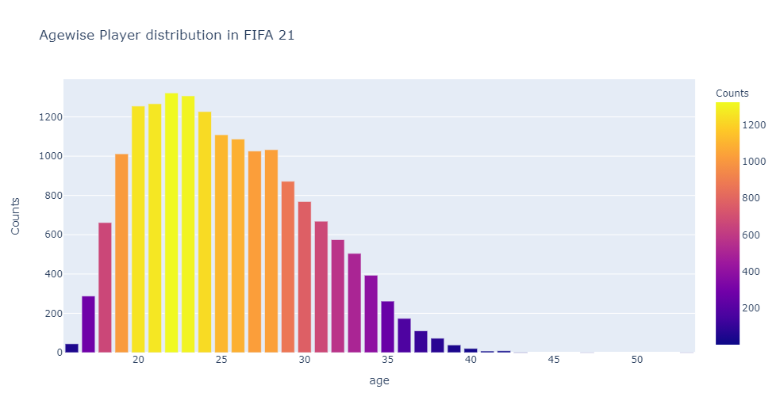
Age distribution

Slide 8
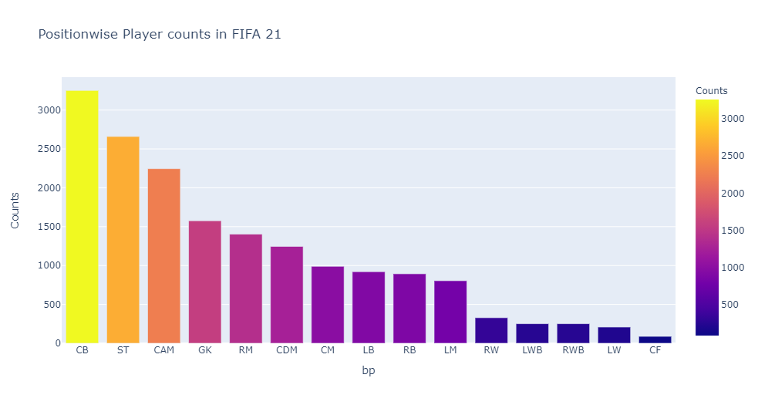
Position distribution

Slide 9
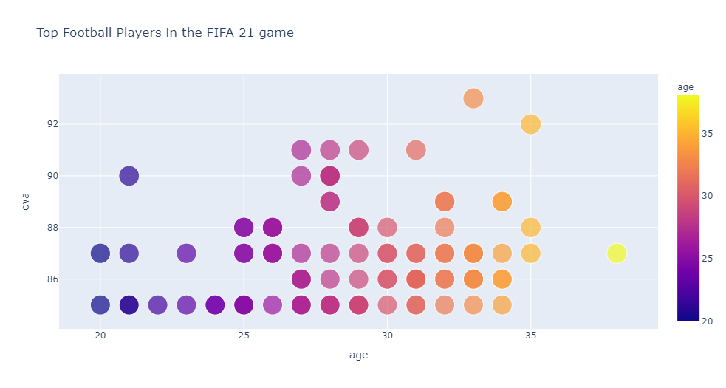
Value by age
Top 2 players seem to be Messi and Ronaldo..
Best under 25 (and 21) is K. Mbappe

Slide 10
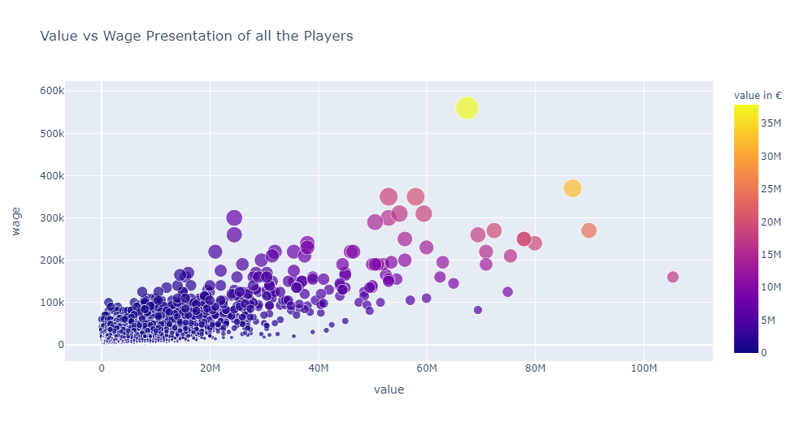
Value and wage
Many outliers at the max (right side). Shows the number of superstars is limited

Slide 11
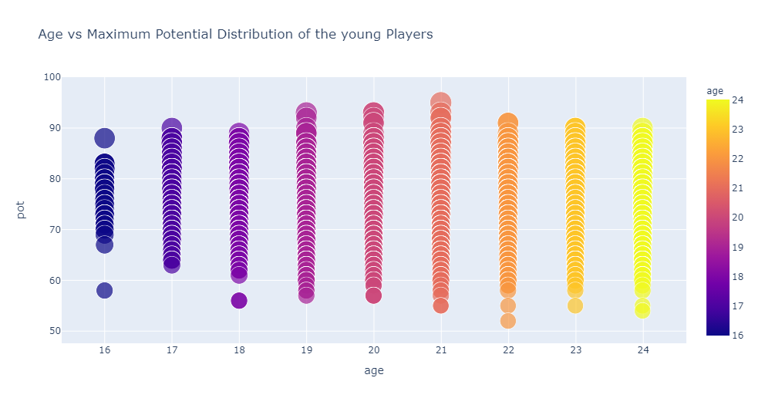
Potential by age
Potential was considered only if different from overall value (as in the player did not reach its maximum value already) and only for players under 25 y

Slide 12
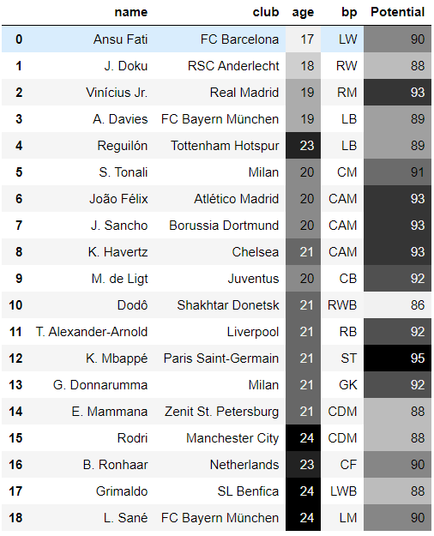
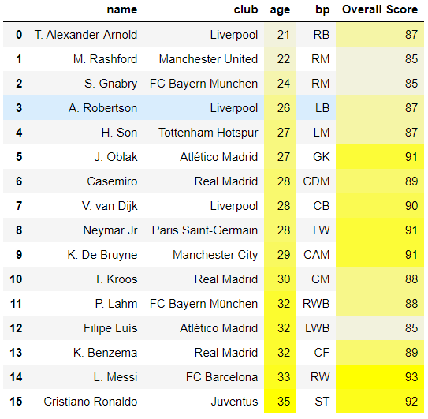
Best players by potential vs best team by ova
ROAS
10.48

Slide 13
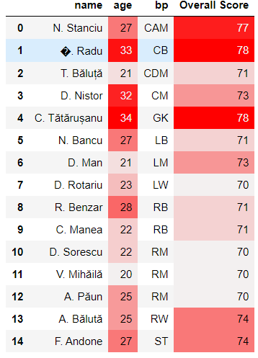
Best Romanian team..
ROAS
10.48

Slide 14
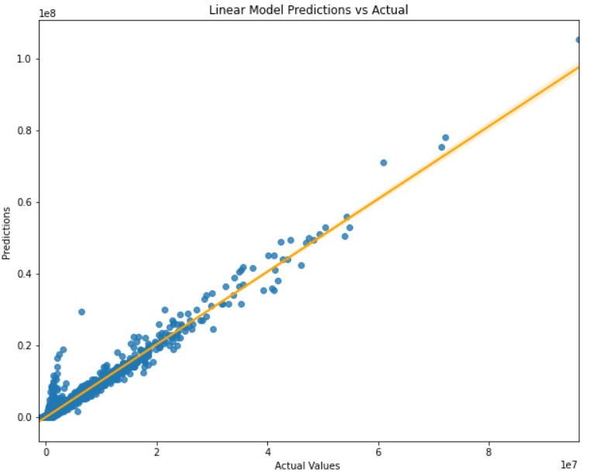
REGRESSION: first method
no scaling / using 'value' as y / using the whole numeric data set as X
X = fifa2021.select_dtypes(include=['float64','int64']).drop(['value'], axis=1)
X = pd.DataFrame(X).fillna(X.mean())
y = fifa2021['value']
…
R2_score: 0.97
RMSE: 1031689.0009986153
ROAS
10.48

Slide 15
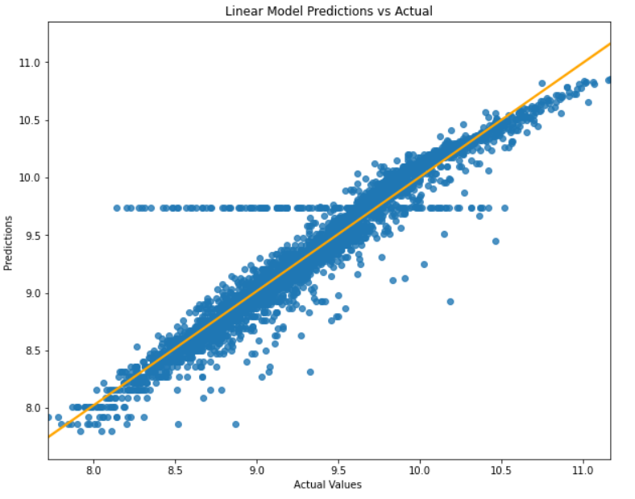
REGRESSION: second method
using only the 'age','value', 'wage','total_stats', 'position', 'ova', 'pot' columns
predicting 'value' by using boxcox transf and lr
fifa2021_more_testing = fifa2021[['age','value', 'wage','total_stats', 'position', 'ova', 'pot']]
df1 = remove_outliers(fifa2021_more_testing, threshold=2)
df2 = remove_outliers(df1, threshold=1.5, in_columns=['value'])
df3 = pd.get_dummies(df2, drop_first=True)
X = df3.drop('value', axis=1)
y = df3['value']
…
r2_score(y_test, predictions) = 0.9169588697407761
mean_absolute_error(y_test, predictions) = 0.09367178456806254
mean_squared_error(y_test, predictions, squared=False) = 0.1600740247572928
Note: tried almost every combo of the following columns - 'name', 'age', 'club','nationality','value', 'wage','total_stats', 'height', 'weight', 'position', 'ova', 'pot'. Left only the highest score (0.91)
ROAS
10.48

Slide 16
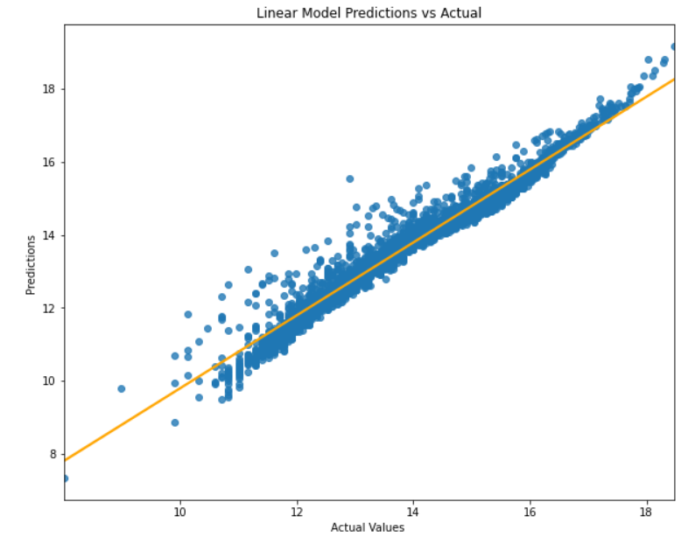
REGRESSION: third method
Tried another approach (with StandardScaler) and lr
Used 'age', 'ova', 'pot' and all skill attributes combined into a new int64 column, 'aggregated_stats'
fifa2021['aggregated_stats'] = fifa2021[['attacking', 'crossing', 'finishing', 'heading_accuracy', 'short_passing', 'volleys', 'dribbling', 'curve', 'fk_accuracy', 'long_passing', 'ball_control', 'movement', 'acceleration', 'sprint_speed', 'agility', 'reactions', 'power', 'shot_power', 'stamina', 'long_shots', 'mentality', 'aggression', 'positioning', 'vision', 'penalties', 'composure', 'pac']].sum(axis=1)
df=fifa2021[['age', 'ova', 'pot', 'aggregated_stats']]
target = np.log1p(fifa2021['value'])
…
MAPE: 2.063%
Train r2 Score: 95.762%
Test r2 Score: 93.616
Adjusted r2 Score: 94.397%
RMSE: 2526851.493447183
MAE: 675089.4907242148
Cross Validation Score: 87.799%
Note: tried not to aggregate the stats in one column before, got a better score when I did aggregate (I’m showing here my best result)
ROAS
10.48

Slide 17
Conclusions
Very complete dataset, can do a lot of modelling on it, depending on what you want to show/find out
Can be quite challenging to clean up
Also quite challenging to choose what to explore exactly
Google is your friend…
… but Google can also be a time-wasting blackhole
Many many many indians!
Plotly.express is an amazing find!
Found this YouTube channel that is quite nice to understand (and explain to newbies) ML things : https://www.youtube.com/channel/UCbOX--VOebPe-MMRkatFRxw
Somehow, I feel dumber than before, having done all these exercises :)

